Slide 1
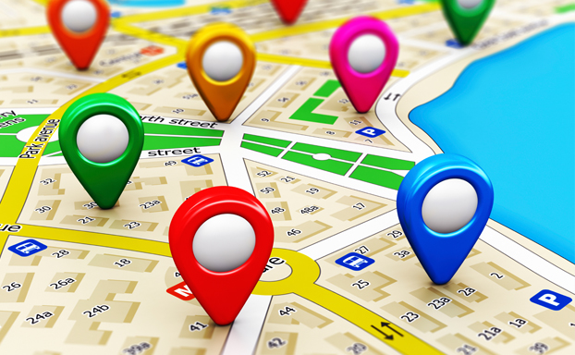
End to End Implementation of Location-based Service

Slide 2
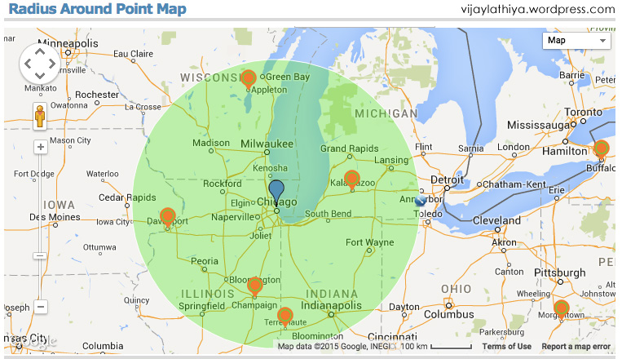
Location-Based Search using Geocoding

Slide 3

Amazon Location Service

Slide 4
Amazon Location Service is a location-based service that developers can use to add geospatial data and location functionality to applications.

Slide 5
Location-Based Search using Geocoding

Slide 6

Amazon Location Place Index resource
An Amazon Location Place Index resource is a geographical search engine that you can use to search for points of interest, street addresses (geocode), and geographical coordinates (reverse geocode).
On Amazon Location, you can select a data provider best for your use case when creating a Place Index resource.
Once the resource is created, you can make search requests by using the Places API.

Slide 7
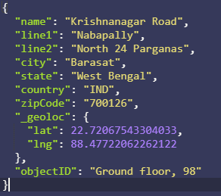
{
"locationId": "Ground floor, 98",
"name": "Krishnanagar Road",
"line1": "Nabapally",
"line2": "North 24 Parganas",
"city": "Barasat",
"state": "West Bengal",
"country": "IND",
"zipCode": "700126"
}

Slide 8
Location-Based Search using Geocoding

Slide 9

Algolia is a proprietary search engine offering, usable through the software as a service (SaaS) model.

Slide 10
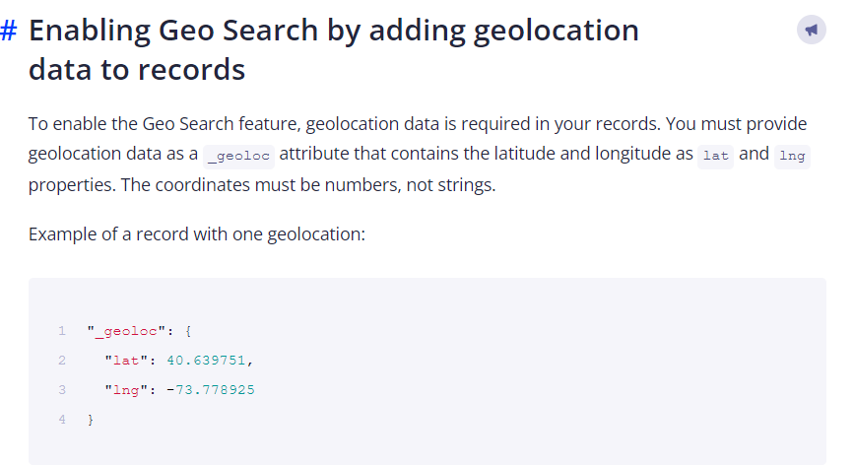
Geo Search
Geo Search is a way to filter and sort results by distance or around certain geographical locations.

Slide 11
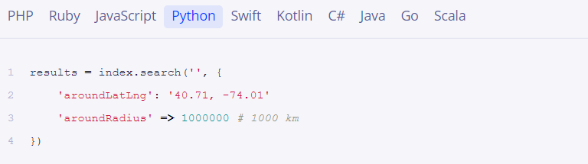
An empty query ('') tells Algolia to retrieve all data points…

Slide 12
{
"locationId": "Ground floor, 98",
"name": "Krishnanagar Road",
"line1": "Nabapally",
"line2": "North 24 Parganas",
"city": "Barasat",
"state": "West Bengal",
"country": "IND",
"zipCode": "700126"
}

Slide 13
